Slide 1






Introduction to Servlets
Tomcat, Servlets, JSP
Introduction
to Servlets
SoftUni Team
Technical Trainers
Software University
http://softuni.bg

Slide 2


Table of Contents
Apache Tomcat
Java Servlets
Routing
State Management
MVC
JSP
JSTL
EL

Slide 3
Have a Question?
sli.do #JavaWeb

Slide 4

Apache Tomcat

Slide 5
What is a Apache Tomcat?
Open-source Java Servlet Container developed by the Apache Software Foundation
Implements Java Servlet, JSP, Java EL, WebSockets
Provides HTTP Server
Download Tomcat from:
https://tomcat.apache.org/download-80.cgi

Slide 6
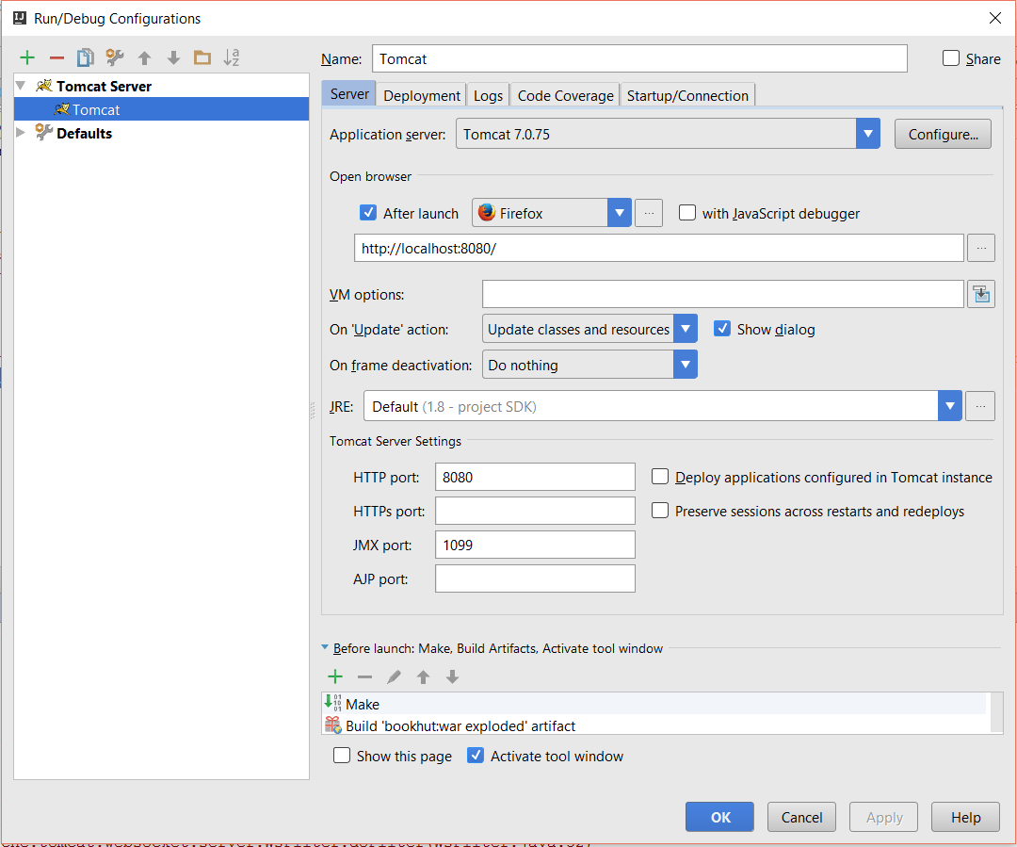
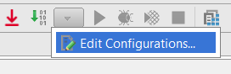
Tomcat Setup
Add Tomcat
Tomcat Server
URL
Default Action
HTTP Port

Slide 7
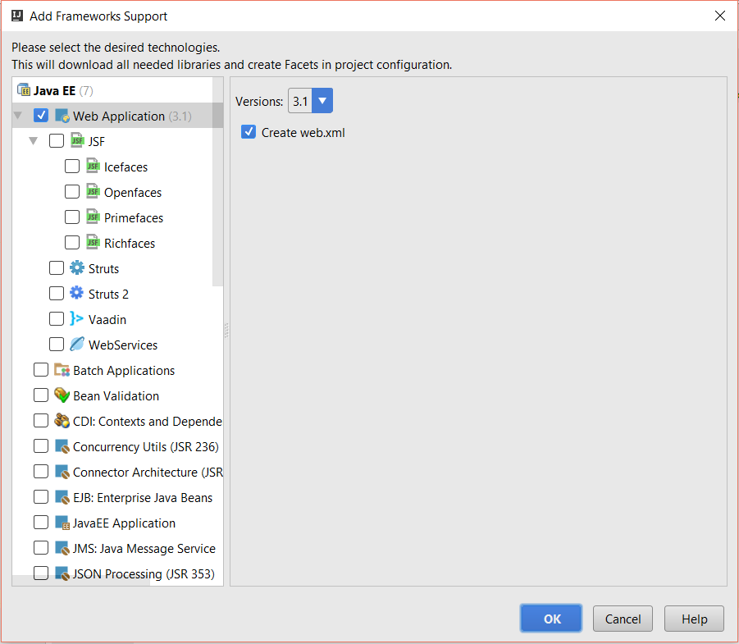
Java EE Support
Web Support
Web XML

Slide 8
Java Servlets

Slide 9
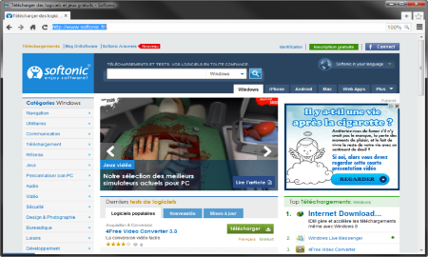





Java Servlets
Programs that run on a Web/Application server and act as a middle layer between a request coming from a web browser
Web Client
Web Server
Request
Request
Servlet
Database
Data
Response
Response

Slide 10
Maven Dependencies
pom.xml
<dependency>
<groupId>javax</groupId>
<artifactId>javaee-api</artifactId>
<version>7.0</version>
</dependency>

Slide 11
Servlet Example
URL pattern
Servlet.java
@WebServlet("/home")
public class Servlet extends HttpServlet {
protected void doPost(HttpServletRequest request,
HttpServletResponse response)
throws ServletException, IOException {
}
protected void doGet(HttpServletRequest request,
HttpServletResponse response)
throws ServletException, IOException {
}
}
Handle Post requests
Handle Get requests

Slide 12
URL Patterns
@WebServlet("/") – default servlet. Listens to everything that doesn’t match other patterns.
@WebServlet("/*") – listen to everything and overrides othe paths.
@WebServlet("") – listen to only application root
@WebServlet("/home") – listen to only /home route.
@WebServlet("/*.html") – extention mapping

Slide 13
Servlet Lifecycle
Java Virtual Machine
Web Server
Servlet Container
Thread 1
init()
Thread 2
service()
Thread 3
destroyed()
Requests

Slide 14
Print Header
Servlet.java
@WebServlet("/header")
public class Servlet extends HttpServlet {
protected void doGet(…) {
PrintWriter out = response.getWriter();
Enumeration<String> headerNames = request.getHeaderNames();
out.println("Header:");
while (headerNames.hasMoreElements()) {
String element = headerNames.nextElement();
String value = request.getHeader(element);
out.println(element + " : " + value);
}
}
}

Slide 15
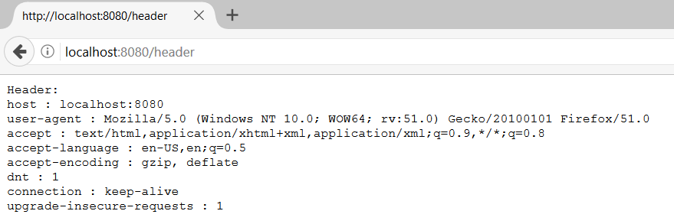
Print Header

Slide 16
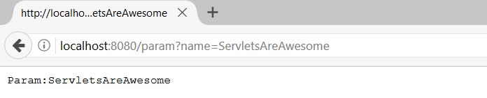
Read Parameter
Servlet.java
@WebServlet("/param")
public class Servlet extends HttpServlet {
protected void doGet(…) {
PrintWriter out = response.getWriter();
String name = request.getParameter("name");
out.println("Param:" + name);
}
}
Param name
Param name

Slide 17
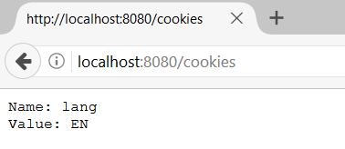
Manipulate Cookies
Servlet.java
@WebServlet("/cookies")
public class Servlet extends HttpServlet {
protected void doGet(…) {
PrintWriter out = response.getWriter();
Cookie languageCookie = new Cookie("lang", "EN");
response.addCookie(languageCookie);
Cookie[] cookies = request.getCookies();
for (Cookie cookie : cookies) {
//TODO: Print the cookies
}
}
}
Create Cookie
Add Cookie
Get Cookie
Notes:
It is possible to invalidate a cookie by invoking the method languageCookie.setMaxAge(0);

Slide 18
Manipulate Sessions (1)
Servlet.java
@WebServlet("/setsession")
public class Servlet extends HttpServlet {
protected void doGet(…) {
HttpSession session = request.getSession();
session.setAttribute("username", "java@softuni.bg");
}
}
Get Session
Set Attribute
Notes:
It is possible to invalidate a cookie by invoking the method languageCookie.setMaxAge(0);

Slide 19
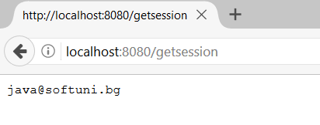
Manipulate Sessions (2)
Servlet.java
@WebServlet("/getsession")
public class Servlet extends HttpServlet {
protected void doGet(…) {
HttpSession session = request.getSession();
String username = session.getAttribute("username").toString();
//TODO: Print the attribute
}
}
Get Session
Get Attribute
Notes:
It is possible to invalidate a cookie by invoking the method languageCookie.setMaxAge(0);

Slide 20
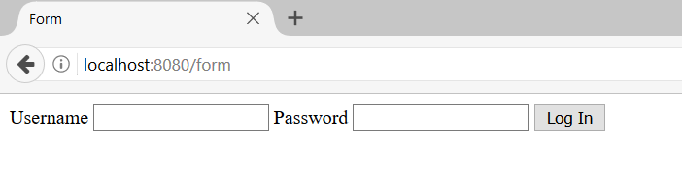
Forwarding
Servlet.java
@WebServlet("/form")
public class Servlet extends HttpServlet {
protected void doGet(…) {
request
.getRequestDispatcher("form.html")
.forward(request, response);
}
}
Forward to form.html
Notes:
It is possible to invalidate a cookie by invoking the method languageCookie.setMaxAge(0);

Slide 21
Read Form Data
Servlet.java
@WebServlet("/form")
public class Servlet extends HttpServlet {
protected void doPost(…) {
String logIn = request.getParameter("login");
if(logIn != null) {
String username = request.getParameter("username");
String password = request.getParameter("password");
form.html
<form method="post">
<input type="text" name="username">
<input type="password" name="password">
<input type="submit" name="login" value="Log In">
</form>

Slide 22
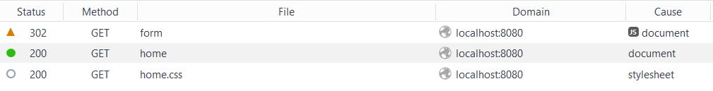
Redirect
Servlet.java
@WebServlet("/form")
public class Servlet extends HttpServlet {
protected void doGet(…) {
response.sendRedirect("/home"); }
}
Redirect to /home
Notes:
It is possible to invalidate a cookie by invoking the method languageCookie.setMaxAge(0);

Slide 23

MVC
Design pattern with three independent components
Model – manages data and application logic
View – presentation layer
Controller – converts the input into commands and sends them to the view or the model

Slide 24
MVC – Control Flow
Web Client
Request
Controller
Response (html, json, xml)
Update Model
User Action
Update View
Notify
Model
View

Slide 25
Overall Architecture
Repository
Service
Controller
Database
View
Entities
Models/ DTO
Back-end

Slide 26
JSP, JSTL, EL

Slide 27
JSP
Technology for developing web pages that support dynamic content
JSP
Web Client
Read
Web Server
Request
Generate
Servlet
Response
Response

Slide 28
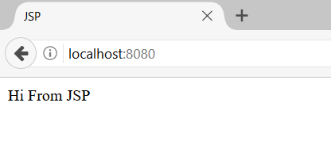
JSP Example
index.jsp
<%@ page contentType="text/html;charset=UTF-8" language="java" %>
<html>
<head>
<title>JSP</title>
</head>
<body>
<%= new String("Hi From JSP")%>
</body>
</html>
Page Directive
Java Code

Slide 29
Syntax
Scriplet – nest Java code
Declaration Tag – define variables
Expression Tag – print java variables
Comment Tag – add comments
<% System.out.println("Message in the Console"); %>
<%! int x = 5; %>
<%= x%>
<%-- This is JSP comment --%>

Slide 30
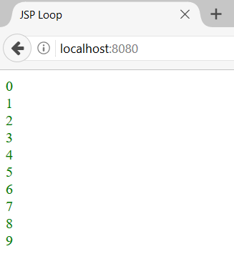
Simple JSP Loop
index.jsp
<%@ page contentType="text/html;charset=UTF-8" language="java" %>
<html>
<body>
<%! int elements = 10;%>
<% for (int i = 0; i < elements; i++) {%>
<div style="color: green">
<%=i%>
</div>
<%}%>
</body>
</html>
Declare Variable
Prepare Loop
Print Value

Slide 31
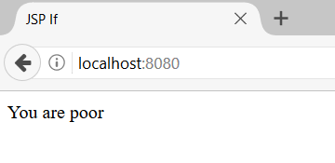
JSP Conditional Statement
index.jsp
<%@ page contentType="text/html;charset=UTF-8" language="java" %>
<html>
<body>
<%! int readBooks = 3;%>
<% if(readBooks < 20) {%>
<%= new String("You are poor")%>
<%} else {%>
<%= new String("You are rich")%>
<%}%>
</body>
</html>

Slide 32
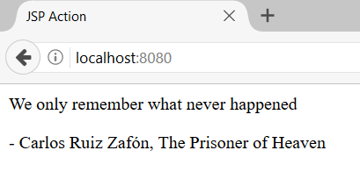
JSP Actions
include.jsp
<body>
<p>- Carlos Ruiz Zafón, The Prisoner of Heaven </p>
</body>
index.jsp
<body>
<p>We only remember what never happened</p>
<jsp:include page="include.jsp"></jsp:include>
</body>
JSP Include Action

Slide 33
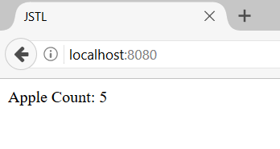
JSTL
Collection of useful JSP tags which encapsulates core functionality common to many JSP applications
index.jsp
<%@ taglib prefix="c" uri="http://java.sun.com/jsp/jstl/core" %>
... <c:set var="apples" value="${5}"/>
<div>
Apple Count: <c:out value="${apples}"/>
</div>
Declare Variable
Assign Value
Print Variable

Slide 34
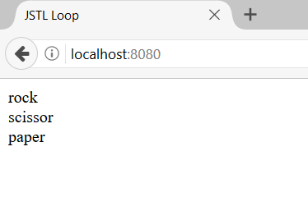
JSTL Simple Loop
Declare Variable
index.jsp
<c:forEach items="rock,scissor,paper" var="item">
<div>
<c:out value="${item}"/>
</div>
</c:forEach>

Slide 35
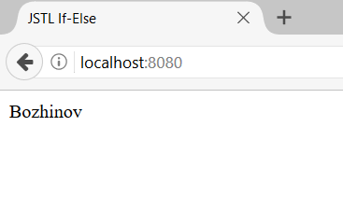
JSTL Conditional Statement
index.jsp
<c:set var="goalsScored" value="${14}"/>
<c:choose>
<c:when test="${goalsScored > 200}">
<div>
Messi
</div>
</c:when>
<c:otherwise>
<div>
Bozhinov
</div>
</c:otherwise>
</c:choose>

Slide 36
Expression Language (1)
JSP EL makes it possible to easily access application data
Servlet.java
protected void doGet(…) {
List<String> weekdays = new ArrayList() {
{
add("Monday");
add("Tuesday"); …
}
};
request.setAttribute("weekdaysParam", weekdays);
request.getRequestDispatcher(“index.jsp").forward(request,response);
}

Slide 37
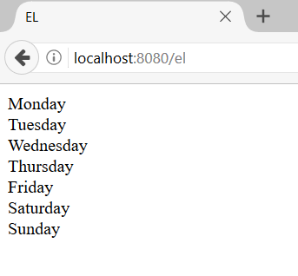
Expression Language (2)
index.jsp
<c:set var="weekdays" value="${weekdaysParam}"/>
<c:forEach items="${weekdays}" var="weekday">
<div>
<c:out value="${weekday}"></c:out>
</div>
</c:forEach>

Slide 38

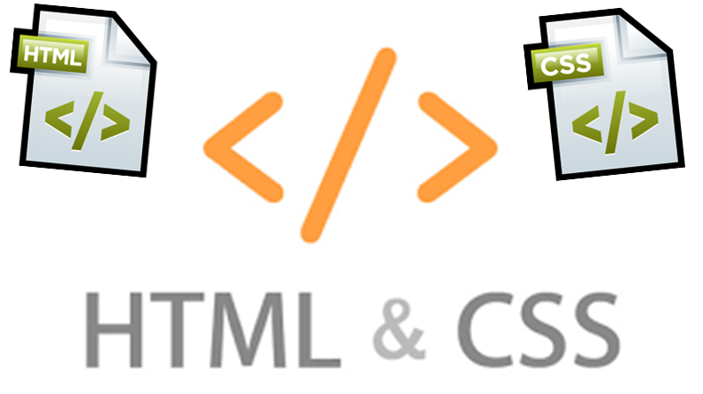
Summary
Servlets are programs that run on a Web/Application server and act as a middle layer
JSP is a technology for developing web pages that support dynamic content

Slide 39








Web Development Basics – Course Overview
https://softuni.bg/courses/

Slide 40
License
This course (slides, examples, demos, videos, homework, etc.) is licensed under the "Creative Commons Attribution-NonCommercial-ShareAlike 4.0 International" license

Slide 41






Free Trainings @ Software University
Software University Foundation – softuni.org
Software University – High-Quality Education, Profession and Job for Software Developers
softuni.bg
Software University @ Facebook
facebook.com/SoftwareUniversity
Software University @ YouTube
youtube.com/SoftwareUniversity
Software University Forums – forum.softuni.bg

